Slide 1
Object Oriented Analysis and Design
Inception Phase and Evolutionary Requirements
COMP 3831
Craig Larman: Chapters 5 and 6
W1L1 Introduction to OOAD
COMP 3831 OOA&D

Slide 2
Activities in the Inception Phase
During the this phase we:
  establish the business case for the system and define the project’s scope.
  create an executable prototype that serves as a proof of concept.
  at the end of the inception phase, you examine the life cycle objectives of the project and decide whether to proceed with full- scale development
W1L1 Introduction to OOAD
COMP 3831 OOA&D

Slide 3
Business Case
The business case includes success criteria, risks assessment, estimates of the resources needed and a phase plan showing a schedule of major millstones.
W1L1 Introduction to OOAD
COMP 3831 OOA&D

Slide 4
Objectives of the Inception Phase – Resolve the System Scope
  Define the scope of the proposed system.
  Draws a line around exactly what is to be within the proposed system and what is outside.
  Defines the external actors, which may be other systems or people which the system is to interact and it specifies at a high level the nature of this interaction.
W1L1 Introduction to OOAD
COMP 3831 OOA&D

Slide 5
Resolve the System Scope - Questions
  Is what is to be within the system clear ?
  Are all the actors identified ?
  Is the general nature of the interfaces (user interfaces and communication protocols) to the actors identified ?
  Can what is within the scope stand by itself as a functioning system ?
W1L1 Introduction to OOAD
COMP 3831 OOA&D

Slide 6
Resolve Ambiguities in the Requirements Needed in this Phase
  The requirements at the beginning of the inception phase may range from a broad vision to many pages of textual description. However, these initial requirements are likely to contain ambiguities. In the inception phase an effort is made to avoid these ambiguities.
W1L1 Introduction to OOAD
COMP 3831 OOA&D

Slide 7
Resolve Ambiguities - Questions
  Has the limited number of use-case requirements (functional as well as non functional ) needed to reach the objectives of this phase been identified and detailed ?
  Have requirements been identified and detailed in the supplementary requirements?
W1L1 Introduction to OOAD
COMP 3831 OOA&D

Slide 8
Establish a Candidate Architecture
  Why should an organization focus on an architecture?
  Lets you gain and retain Intellectual Control over the project.
  Reuse
  Provides a basis for project management.
W1L1 Introduction to OOAD
COMP 3831 OOA&D

Slide 9
Establish a Candidate Architecture –Questions?
  Does it meet user’s needs?
  Is it likely to work ?
W1L1 Introduction to OOAD
COMP 3831 OOA&D

Slide 10
Objectives of the Inception Phase (cont)
Estimate Risks
  Many difficult projects have failed because they encountered critical risks.
Estimate the Cost and Schedule
  Overall cost and schedule for the entire project.
Identify the primary scenarios of behavior (use cases) of the system
  These use cases will drive the systems functionality.
W1L1 Introduction to OOAD
COMP 3831 OOA&D

Slide 11
Estimate Risks - Questions
Have all the critical risks have been identified ?
Have the identified risks been mitigated or is there a plan for mitigating them?
W1L1 Introduction to OOAD
COMP 3831 OOA&D

Slide 12
Outcomes of the Inception Phase
A vision document : general vision of the core project requirements, key features, and main constraints.
A first version of a business( or domain) model that describes the context of the system
A first cut of the models representing a first version of the use-case model, the analysis model, the design model. Of the implementation model and test model, there may be something rudimentary. There is also a first version of the supplementary requirements
W1L1 Introduction to OOAD
COMP 3831 OOA&D

Slide 13
Outcomes of the Inception Phase (cont)
A first draft of a candidate architecture description with outlines of views of the use case, analysis, design and implementation models
Possibly a proof of concept exploratory prototype, demonstrating the use of the new system
An initial risk list and use case ranking list
The beginning of a plan for the entire project, including a general plan for the phases
A first draft of business case, which includes: business context and success criteria (revenue projection, market recognition, project estimate)
W1L1 Introduction to OOAD
COMP 3831 OOA&D

Slide 14
Evolutionary Requirements
W1L1 Introduction to OOAD
COMP 3831 OOA&D

Slide 15
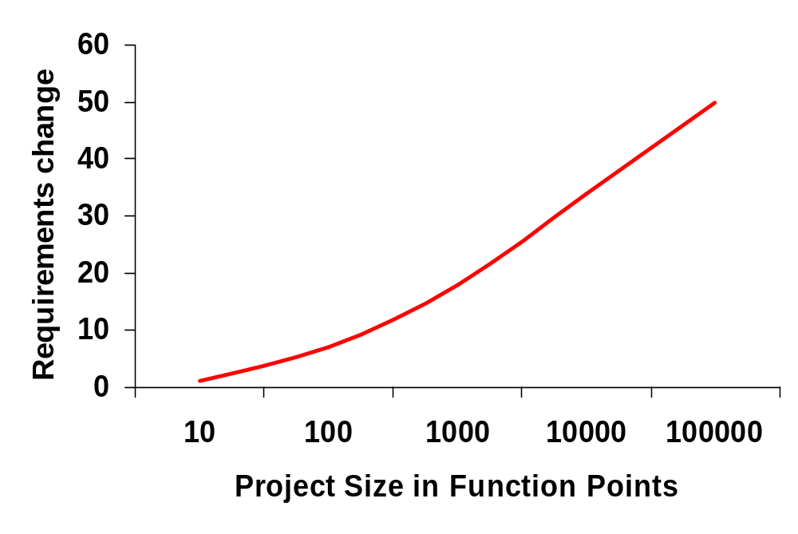
Faulty Assumption 1:
Requirements can be Fairly Accurate
Jones, 1997. Based on 6,700 systems.
W1L1 Introduction to OOAD
COMP 3831 OOA&D

Slide 16
Faulty Assumption 2:
Requirements are Stable
The market changes—constantly.
The technology changes.
The goals of the stakeholders change.
W1L1 Introduction to OOAD
COMP 3831 OOA&D

Slide 17
Faulty Assumption 3: The Design can be Done, before Programming
Ask a programmer.
Requirements are incomplete and changing.
Too many variables, unknowns, and novelties.
A complete specification must be as detailed as code itself.
Software is very “hard”.
  Discover Magazine, 1999: Software characterized as the most complex “machine” humankind builds.
W1L1 Introduction to OOAD
COMP 3831 OOA&D

Slide 18
The Importance of Requirements
Requirements are often taken for granted.
Users know what they want, right?
Well not exactly
Figuring out exactly what a system should be doing is a major undertaking
W1L1 Introduction to OOAD
COMP 3831 OOA&D

Slide 19
Types of requirements (FURPS+)
FURPS
  (F)unctional - features, capabilities, security
  (U)sability - human factors, help, documentation
  (R)eliability - frequency of failure, recoverability, predictability
  (P)erformance - response times, throughput, accuracy, availability, resource usage
  (S)upportability - adaptability, maintainability, internationalization, configurability
W1L1 Introduction to OOAD
COMP 3831 OOA&D

Slide 20
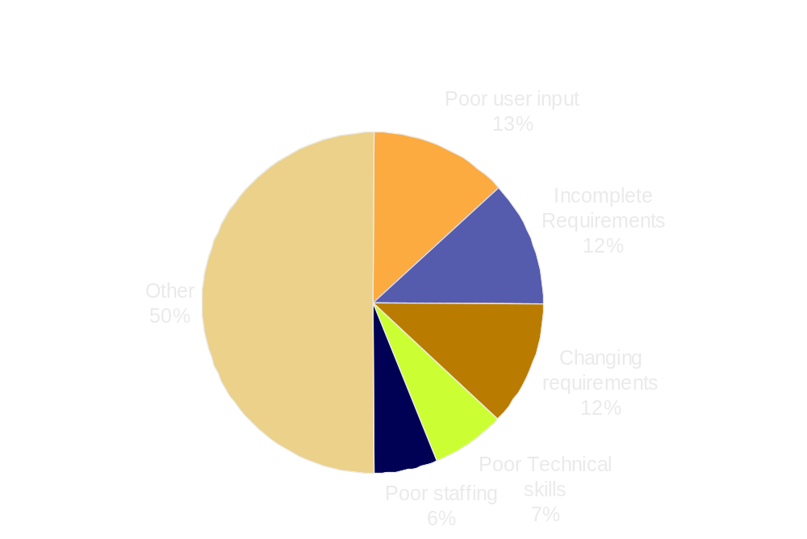
Factors on challenged software projects
37% relate to problems with requirements
W1L1 Introduction to OOAD
COMP 3831 OOA&D

Slide 21
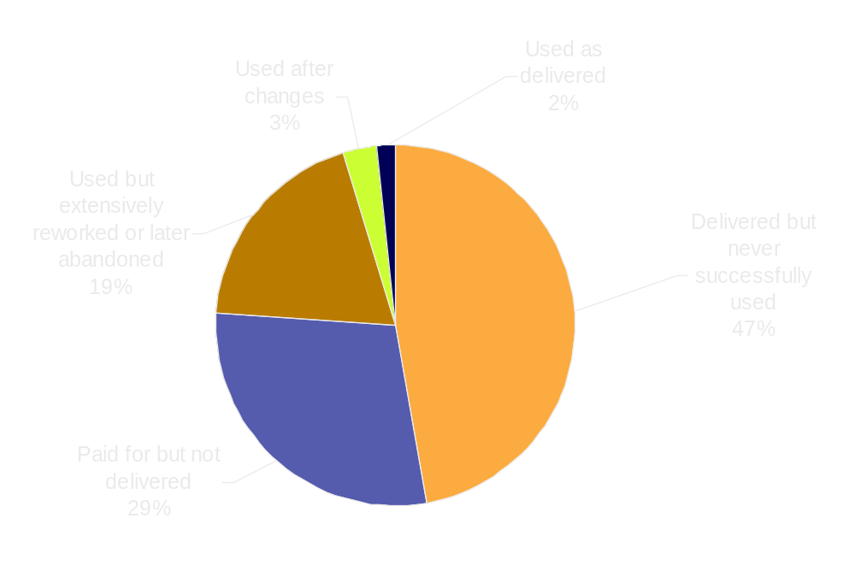
The Rate of Failure
Randomly selected U.S. government software projects:
Source: US Government Accounting Office. Report FGMSD-80-4.
W1L1 Introduction to OOAD
COMP 3831 OOA&D

Slide 22
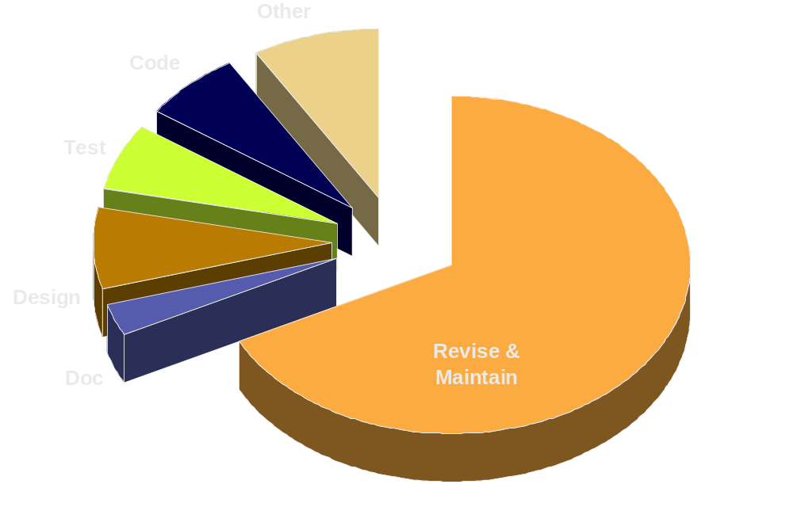
The Cost of Change
Strategic rational system development plans are based on the complete cost of a system, not solely on development costs.
$
$
$
$
$
$
Source: DP Budget, Vol. 7, No. 12, Dec. 1988
W1L1 Introduction to OOAD
COMP 3831 OOA&D

Slide 23
The Cost of Change
An AT&T study indicated that, on average
Business Rules change at
the rate of 8% per month. This would be quite a large change over a year.
W1L1 Introduction to OOAD
COMP 3831 OOA&D

Slide 24
Questions and Conclusions
W1L1 Introduction to OOAD
COMP 3831 OOA&D

